Slide 1
Electrical
and Electronics science
First year
Computer Science and Engineering
Dr. Shakti Singh
ASSISTANT PROFESSOR
ELECTRCIAL AND INSTRUMENATION
ENGINEERING DEPARTMENT
@shakti.singh@thapar.edu

Slide 2
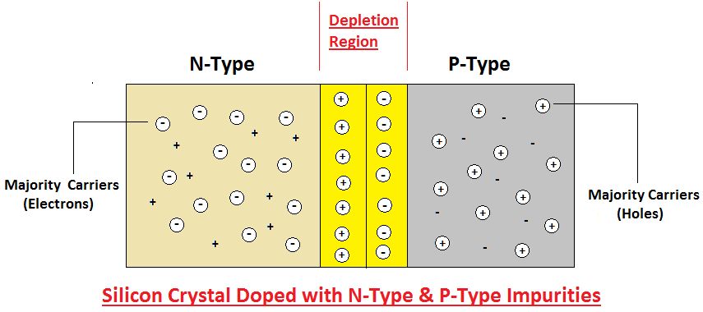
PN Junction
If a piece of intrinsic Si is doped so that part is n-type and other is p-type, a pn junction is formed.
The p region has many holes and few thermally generated electrons.
The n region has many electrons and few thermally generated holes.

Slide 3
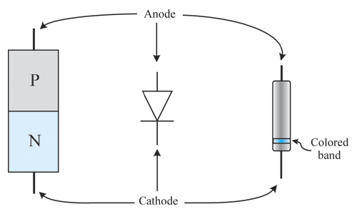
A diode has two leads connected to the external circuit.
Since a diode behaves differently depending upon forward or reverse bias, it is critical to be able to distinguish the leads.
The anode connects to the p-type material, the cathode to the n-type material of the diode.

Slide 4
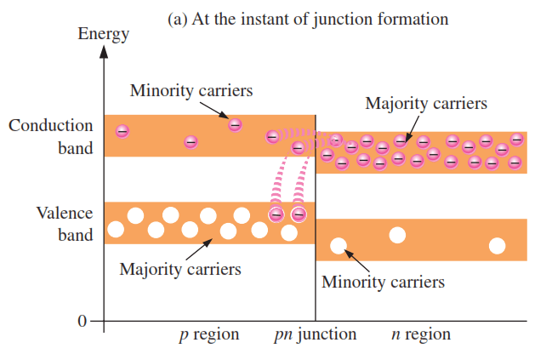
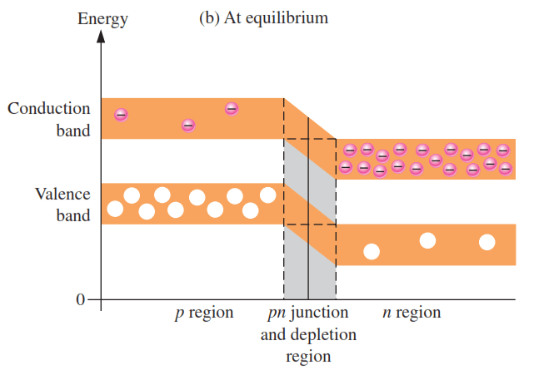
PN Junction
The valence and conduction band in n-type material are slightly at lower level than the p-type material. This is due the fact that n type is formed by pentavalent impurity and p type through trivalent impurity.
The trivalent impurity exert lower force on outer shell electrons than pentavalent impurity. The lower forces in p type means electron orbits are slightly higher than n type.

Slide 5
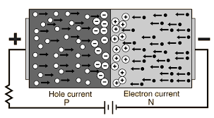
Forward Biased PN Junction
A positive potential on p-type and negative potential on n-type creates a forward biased PN junction.
The negative terminal of battery repels the electrons in the n-type to move towards the depletion region.
The battery potential must be greater than barrier potential to forward bias the PN junction diode.
Now when these electrons overcome the barrier, they enter the p-region. In p region they lost enough energy to immediately combine with holes in the p region.
The holes in the p-region provides a pathway to these valence electrons.
They then enter through the positive terminal of battery.

Slide 6
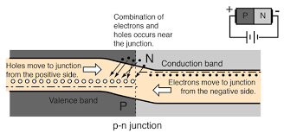
Forward Biased PN Junction
As the electrons flow out of p-region through the external connection, they leave the holes behind in the p-region.
These electrons become the conduction electron in metals due to the energy band diagram.
Also this forward bias results in reduction of depletion layer width.

Slide 7
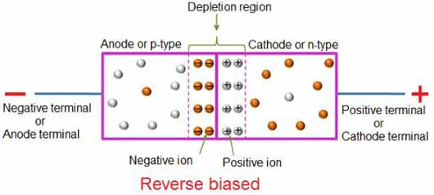
Reverse Biased PN Junction
During reverse biasing, p-region is connected to negative terminal and n-region to positive terminal.
This causes attraction of electrons from n-region and holes from p-region towards the connecting terminals
Thus, when electrons move towards terminal in n-region, it leaves behind positive ions.
This causes widening of depletion layer.

Slide 8
The Biased PN Junction
Forward Bias:
In forward bias the depletion region shrinks slightly in width. With this shrinking the energy required for charge carriers to cross the depletion region decreases exponentially. Therefore, as the applied voltage increases, current starts to flow across the junction. The barrier potential of the diode is the voltage at which appreciable current starts to flow through the diode. The barrier potential varies for different materials.
V_{applied} > 0
Reverse Bias:
Under reverse bias the depletion region widens. This causes the electric field produced by the ions to cancel out the applied reverse bias voltage. A small leakage current, Is (saturation current) flows under reverse bias conditions. This saturation current is made up of electron-hole pairs being produced in the depletion region. Saturation current is sometimes referred to as scale current because of it’s relationship to junction temperature.
V_{applied} < 0

